Slide 1
EPICS Database Exercises
Kay Kasemir
Many slides from Andrew Johnson, APS/ANL
Jan. 2022

Slide 2
Extending “ramp_with_limit.db” further
Add a “$(S):step” record and use it in the CALC to allow stepping the ramp in increments between 0.1 and 5.
Create a display for all 3 records.
Make the “..ramp” display units of “a.u.” and have it show 2 digits after the decimal point
Add a widget to the display that allows controlling the rate at which the logic processes
Configure the “..ramp” to generate an alarm when the value is above 8
Configure the “..ramp” to only send values to an archive when the value changes by 2 or more
Add an analog output record which, when processed, resets the “..:limit” to 10. Add a button to the display which triggers this reset.
# A ramp from 0 to 'limit', were limit
# can be configured via a separate record
record(ao, "$(S):limit")
{
field(DRVH, "100")
field(DOL, "10")
field(PINI, "YES")
}
record(calc, "$(S):ramp")
{
field(SCAN, "1 second")
field(INPA, "$(S):ramp")
field(INPB, "$(S):limit")
field(CALC, "A<B ? A+1 : 0")
}

Slide 3
Binary records
Create a BO with values “Normal” and “Doubled”, add to display
Use in the “..:ramp” to double the effective step size
Configure the BO such that when setting it to “Doubled”, it will revert to “Normal” after 5 seconds

Slide 4
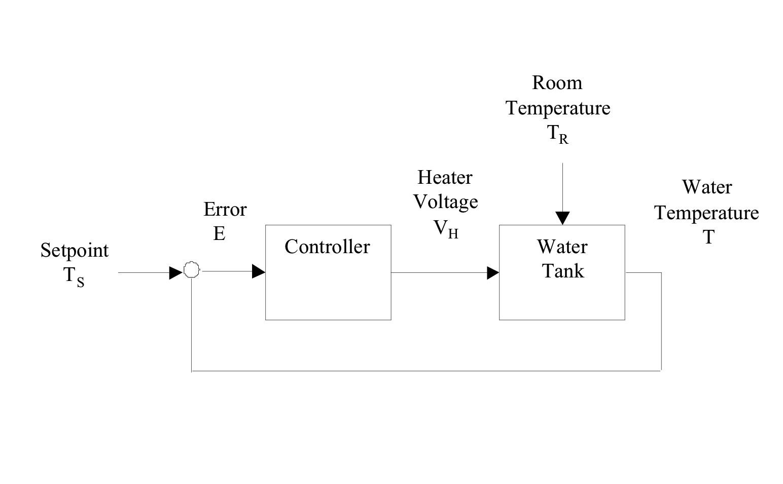
Heater Control Simulation
Typical control loop
PID Controller
  O(n) = K_{P} E(n) + K_{I}Σ_{i}E(i) dT + K_{D} [E(n)-E(n-1)]/dT
  Update period dT
  Error readings E(n)
  Output O(n)
  Proportional Gain K_{P}, Integral K_{I}, Derivative K_{D}
-

Slide 5
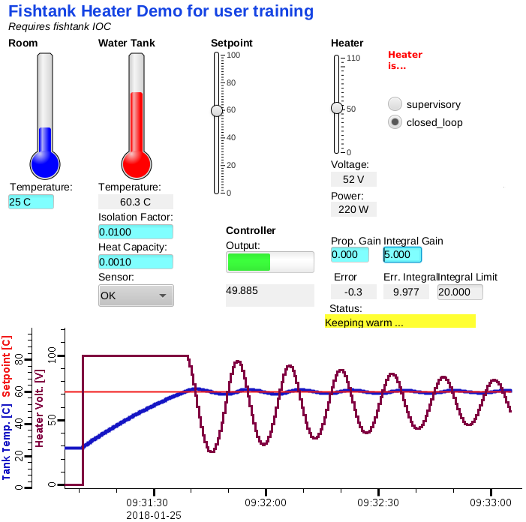
Study the ”fishtank” example
Go to examples/*fishtank
Start IOC: ./st.cmd
Open heater.bob

Slide 6
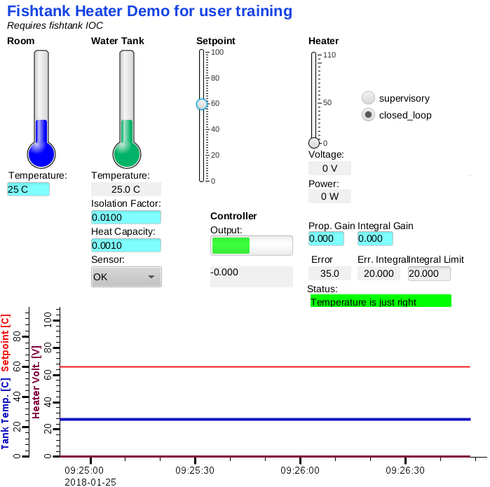
No Control
Set the Prop and Int. gain to zero
Verify that tank temperature ignores the Setpoint
Constant Error

Slide 7
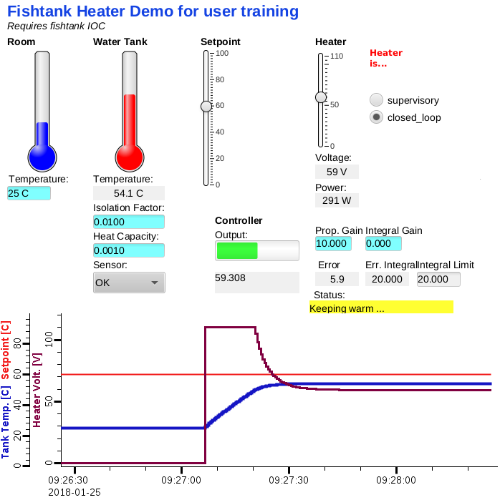
Only Proportional Control
Set the Prop. gain
Verify that tank temperature reacts to setpoint, but doesn’t quite reach it
Small residual
Error

Slide 8
Only Integral Control
Set only the Integral gain
Verify that tank temperature reacts to setpoint. Can you find a good value for the int. gain?
Eventually,
no Error!
.. but Ringing

Slide 9
Study database: User Inputs to Simulation
Note use of Macros
Note use of Analog Output for user Input because of DRVL/DRVL
record(ao, "$(user):room")
{
field(DESC, "Room Temperature")
field(EGU, "C")
field(HOPR, "40")
field(LOPR, "0")
field(DRVL, "0")
field(DRVH, "40")
field(DOL, "25")
field(PINI, "YES")
}
record(ao, "$(user):setpoint")
{
field(DESC, "Temperature Setpoint")
field(EGU, "C")
field(HOPR, "0")
field(LOPR, "100")
field(DRVL, "0")
field(DRVH, "100")
field(PREC, "1")
field(DOL, "30")
field(PINI, "YES")
}

Slide 10
Simulated Tank Temperature
# supervisory: user can adjust voltage
# closed_loop: PID (in separate control.db) sets voltage
# When PID is INVALID, go back to 0 voltage
record(ao, "$(user):heat_V")
{
field(DESC, "Heater Voltage")
field(EGU, "V")
field(DRVL,"0")
field(DRVH,"110")
field(DOL, "$(user):PID MS")
field(OMSL,"closed_loop")
field(IVOA, "Set output to IVOV")
field(IVOV, "0")
}
# ~1100 Watt heater when run with 110V:
# P = U I = U^2 / R, R~12 Ohm
record(calc, "$(user):heat_Pwr")
{
field(DESC, "Heater Power")
field(EGU, "W")
field(INPA, "$(user):heat_V PP NMS")
field(CALC, "A*A/12.1")
}
# Every second, calculate new temperature
# based on current temperature,
# room temperature and heater
#
# A - current temperature
# B - room temperature
# C - heater power
# D - isolation factor (water <-> room)
# E - heat capacity (would really depend on water volume)
#
# Very roughly with
# T(n+1) = T(n) + [Troom-T(n)]*Isolation_factor
# + heater_pwr * heat_capacity
record(calc, "$(user):tank_clc")
{
field(DESC,"Water Tank Simulation")
field(SCAN,"1 second")
field(INPA,"$(user):tank_clc.VAL")
field(INPB,"$(user):room")
field(INPC,"$(user):heat_Pwr PP NMS")
field(INPD,"0.01")
field(INPE,"0.001")
field(CALC,"A+(B-A)*D+C*E")
field(FLNK,"$(user):tank")
}
What causes all these records to process?

Slide 11
PID (without D) Computation
# Error computation’s SCAN drives the rest
record(calc, "$(user):error")
{
field(DESC, "Temperature Error")
field(SCAN, "1 second")
field(INPA, "$(user):setpoint")
field(INPB, "$(user):tank MS")
field(CALC, "A-B")
field(PREC, "1")
field(FLNK, "$(user):integral")
}
# Integrate error (A) but assert that
# it stays within limits (C)
record(calc, "$(user):integral")
{
field(DESC, "Integrate Error for PID")
field(PREC, "3")
field(INPA, "$(user):error PP MS")
field(INPB, "$(user):integral")
field(INPC, "20.0")
field(CALC, "(B+A>C)?C:(B+A<-C)?(-C):(B+A)")
field(FLNK, "$(user):PID")
}
# PID (PI) computation of new output
# A - Kp
# B - error
# C - Ki
# D - error integral
record(calc, "$(user):PID")
{
field(DESC, "Water Tank PID")
field(PREC, "3")
field(LOPR, "0")
field(HOPR, "110")
field(INPA, "10.0")
field(INPB, "$(user):error MS")
field(INPC, "5.0")
field(INPD, "$(user):integral MS")
field(CALC, "A*B+C*D")
}

Slide 12
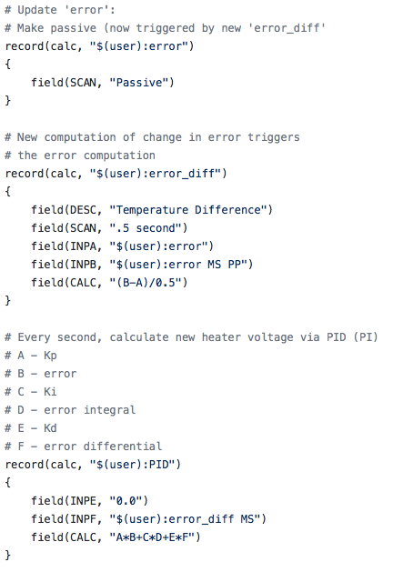
Add Differential Control
”Patch” database
How does it change the processing of records?

Slide 13
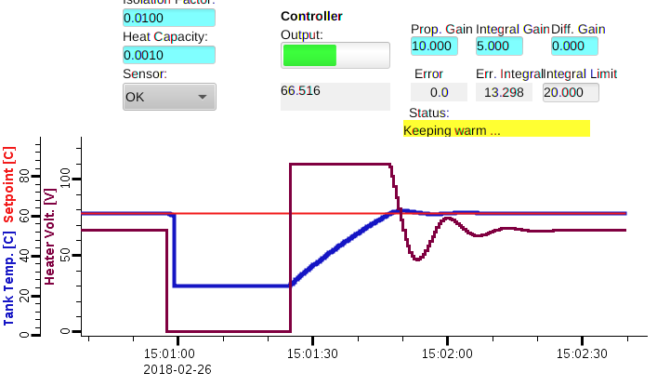
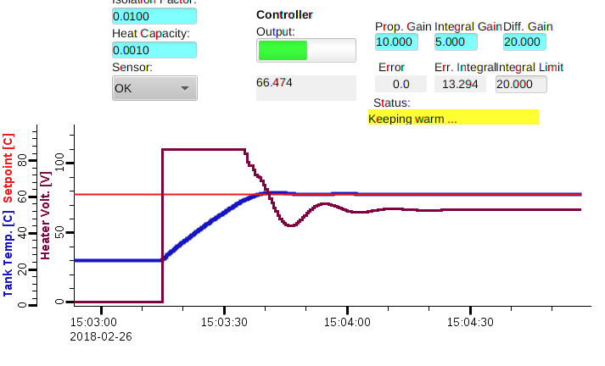
Adding Differential Control
Lower over/undershoot

Slide 14
Things to try
Build a simple on/off fish tank controller
  Simulate the heater
    ‘bo’ record to turn on/off
  Simulate the water temperature
    ‘calc’ record(s):
      Temperature rises when heater is on
      Temperature drops to room temperature when heater is off
  Add controller
    ‘ao’ record to allow entering the desired temperature
    ‘calc’ record(s) to turn heater on/off, automagically keeping water temp. close to setpoint
OK to take inspiration from Heater Control Simulation example
  But don’t copy anything without understanding it
  Compare behavior of the P-I controller with on/off controller

